Slide 1

Day 1 (02/04/2016)
D-Code

Slide 2
Welcome!
Notes:
(“Good to meet you, I’m Kyle”
“I’m Brandy”
“let’s get started”)

Slide 3
Today’s Goals
Meet the Instructors
Discuss our goals
Craft our team agreement
Meet the team
Discuss our workflow
What is programming?
DEV TIME!

Slide 4
The Instructors

Slide 5
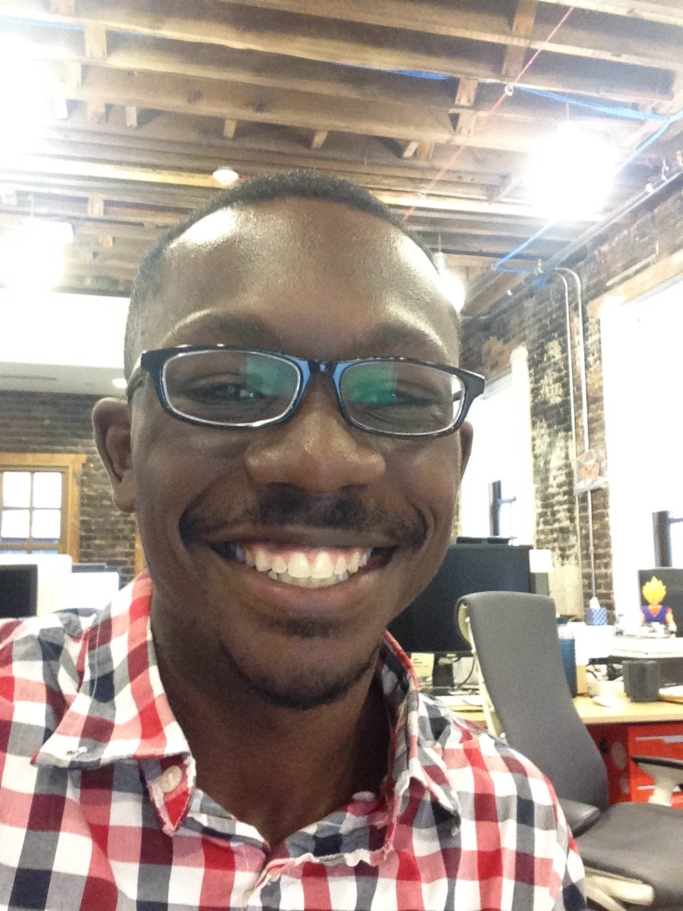
Kyle
Java/Android developer
Grew up in Ohio
Enjoy traveling and learning about different places
Graduated from Princeton
Like cereal, especially Honey Bunches of Oats
Into French hip-hop/pop at the moment

Slide 6
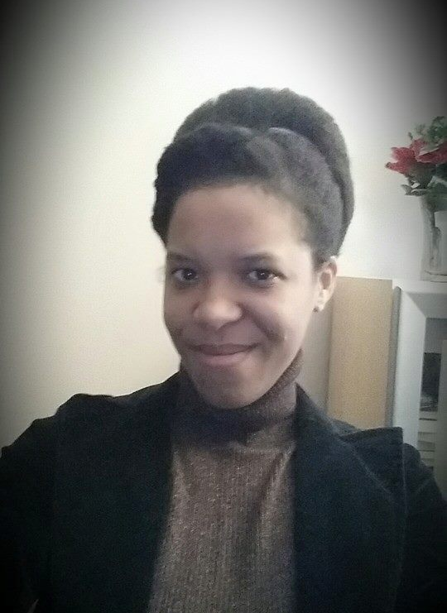
Brandy
Writer of Code (Java)
Writer of Words (Poetry)
Mom of two small humans
Detroit Born and Raised
Halo Mistress Chief (Ubisoft)
Reader of Sci-Fi
Part Android

Slide 7
Today’s Goals
Meet the Instructors
Discuss our goals
Craft our team agreement
Meet the team
Discuss our workflow
What is programming?
DEV TIME!

Slide 8
Why are we here?

Slide 9
Team Goals
Introduce you to the world of software development
Learn the basics of Javascript, HTML and CSS
Use what we learn to ship something cool

Slide 10
Why are you here?

Slide 11
Individual Goals
A software developer’s most important development is themselves.
Remember that there is always something new to learn and we should be willing to learn something new every chance we get.
You will never know everything…
but you can always google it.

Slide 12
Goal Map
Notes:
In this program, it’ll be clear that only you can make yourself get the knowledge you want. That should be maybe a little scary, but also empowering!
Have students record 3 goals you have for yourself for this class.
Have students record 3 apprehensions they have about meeting their goals.

Slide 13
Today’s Goals
Meet the Instructors
Discuss our goals
Craft our team agreement
Meet the team
Discuss our workflow
What is programming?
DEV TIME!

Slide 14
Why a team agreement?

Slide 15
Why a team agreement?
Your reasons: _________
How have computers taken over the world?
Notes:
Ask students why they think we’re putting procedures in, especially when we’re not their classroom teachers.
Motivating story: Why do you think computers taken over the world (become so popular)? (Fish for answers)
*Because they do what they do well. Take in the input, put out the output, not wasting time.
*Individual tasks not complicated, but so efficient that they do great things.
*All parts must work together cohesively.
*We want our class to be like that—working as one unit, each person doing their best.
*We want to avoid things that will break the machine—negative feelings, poor communication...
*We want you to maximize your potential and be happy to learn.

Slide 16
It’s like a contract… but collaborative

Slide 17
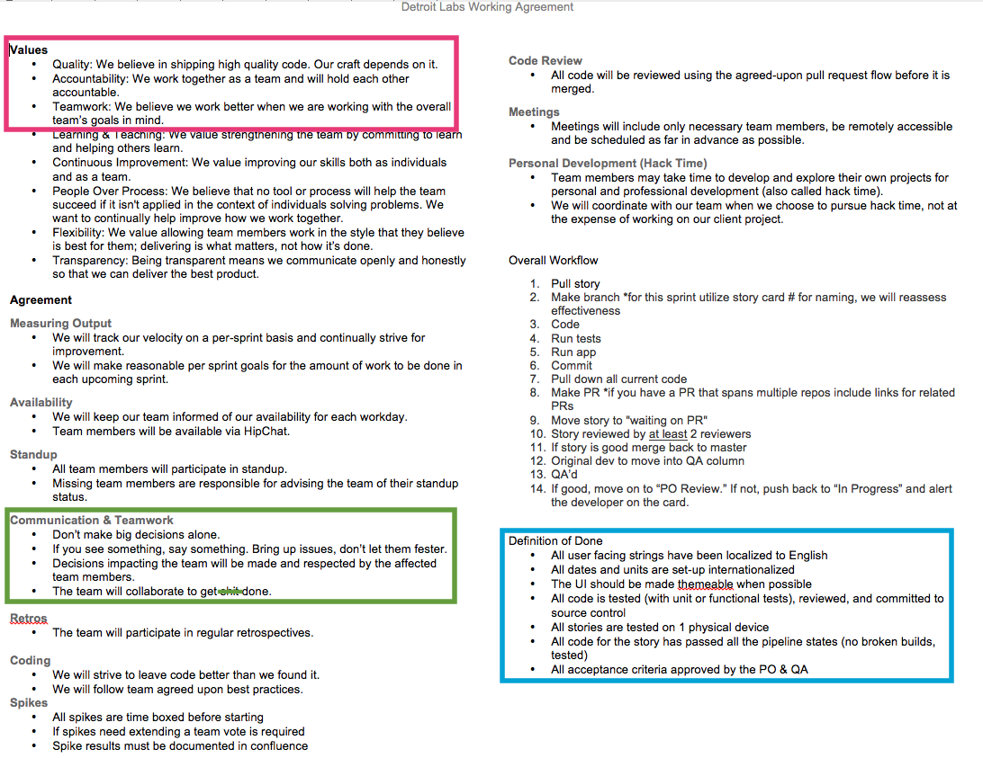
Notes:
Just want to go over bits and pieces of Brandy’s team’s working agreement at a high level (not get lost in all the detail):
Purpose is to show how we want to work as a team, from values to particular processes.
For our purposes, most important thing is values; we’ll learn the processes as we go on.

Slide 18
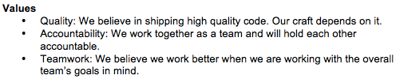
Sample Team Agreement

Slide 19
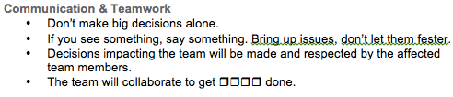
Sample Team Agreement
Notes:
An example of an important section. Others include “who should meetings involve”, “do we review each other’s code”, “how do we keep people in the loop about our availability”…

Slide 20
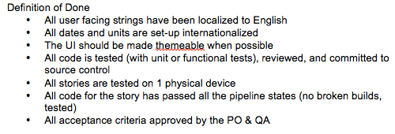
Sample Team Agreement
Notes:
(Focus on what the definition of done is about, gloss over jargon)

Slide 21
D-Code Team Agreement
Some things to keep in mind while we’re crafting our agreement:
Team agreements are social contracts that outline how we will work as a team.
While every single team member is vital to the whole, we succeed or fail as a unit.
Give your opinions respectfully and receive other’s with equal respect.
Notes:
We will hold ourselves to standard we come up with.
Value we would like to include: Respect, Integrity and the Right Effort (not just acting for action’s sake)…
Time Commitment / Availability
We will be present each scheduled class.
We will be focused on our learning materials for that day.
If we know we will be absent we will let our team know.
Communication and Teamwork
We will communicate with respect to everyone.
We will give and receive constructive feedback.
We will get input from team members before making decisions that affect the team.
Effort
We will do our best to meet our deadlines.
If we cannot meet our deadlines, we will give our team members enough advance notice.
Coding and Code Review
We will write our best code.
We will follow Boy Scout Rules : “Leave it better than you found it”
We will be respectful and encouraging to teammates during code reviews, keeping in mind that we are all learning.
Personal Development
We will study on our own to further progress our knowledge (and bring it back to share!).

Slide 22
The Consequences
Since we all agree on this, breaking the team agreement will result in a reminder the first time. Continuing the behavior will lead to a final warning.
Because this behavior leads to a poorly-functioning team, a team member who continues past the final warning will be asked to leave the class.
Since we are a team, we want to encourage each other to keep the agreement.
Notes:
-Don’t expect that it will come to this.
-Not our job; here to teach you something new.
-Also, we’re understanding people—if having a rough day, you can talk to us, but can’t ruin things for others.

Slide 23
Questions?

Slide 24
Today’s Goals
Meet the Instructors
Discuss our goals
Craft our team agreement
Meet the team
Discuss our workflow
What is programming?
DEV TIME!

Slide 25
Meet the Team
There are two teams.
Everyone write a fact about themselves and put it in their team’s bag. Then, the teams switch bags.
The first person pulls out a fact and reads it aloud.
Then, they have one chance to guess who the fact belongs to, after deliberating with your team (don’t think too long – you only have 5 seconds).
If they get it right, their team gets a point. (If they get it wrong, don’t give it away yet!)
The other team guesses next. Continue until everyone has guessed.
Notes:
Directions for participants: The first student will read the fact aloud, guess who it belongs to. Limit 2 guesses. Then owner identifies themselves and restates their name and fact. Team (Everyone) gets a point for every right fact guess. Then, pass the bag on to the next student.

Slide 26
Today’s Goals
Meet the Instructors
Discuss our goals
Craft our team agreement
Meet the team
Discuss our workflow
What is programming?
DEV TIME!

Slide 27
How will this work?

Slide 28
Flow of Class
Review
Teaching & Exercise
Little bit of us talking or showing you a concept
Practice that concept on your own
Come back together, share and compare methods
Individual work time

Slide 29
Today’s Goals
Meet the Instructors
Craft our team agreement
Meet the team
Discuss our goals
Discuss our workflow
What is programming?
DEV TIME!

Slide 30
break;
What is programming?
Notes:
Ask students to answer this question in their own words?

Slide 31
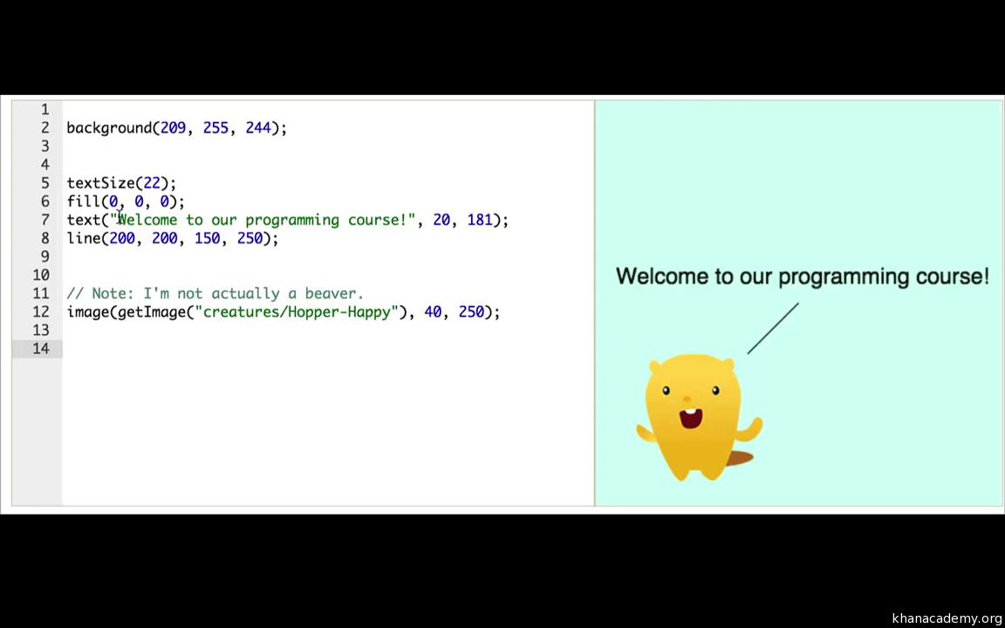

Slide 32
Anatomy of an EarSketch Project: What is programming?
Computer code is a collection of typed words that the computer can clearly understand. Just as a human translator might translate from the English language to Spanish, the computer interprets these words as ones and zeros. We as humans use programming languages, instead of writing directly in ones and zeros, so we can easily write and understand the computer code and can organize it.
Notes:
This is a definition we found online from Georgia Institute of Technology that we thought was pretty clear.

Slide 33
We can think of the different lines of our code as being individual instructions that we give to the computer. The computer follows these instructions explicitly to execute our written code.
http://earsketch.gatech.edu/category/learning/anatomy-of-an-earsketch-project/what-is-programming

Slide 34
continue;
We know that was a lot of information to take in but we promise that as we work together as a development team, utilizing these concepts to create viable products, and learning new and exciting concepts and tools, this first day will seem like the breeze.

Slide 35
Today’s Goals
Meet the Instructors
Craft our team agreement
Meet the team
Discuss our goals
Discuss our workflow
What is programming?
DEV TIME!

Slide 36
Developers Use Tools
Explore the Developer Tools - instructions (for Google Chrome)
Click “View”
Click “Developer”
Click “Developer Tools”
OR - Command + Option+ I

Slide 37
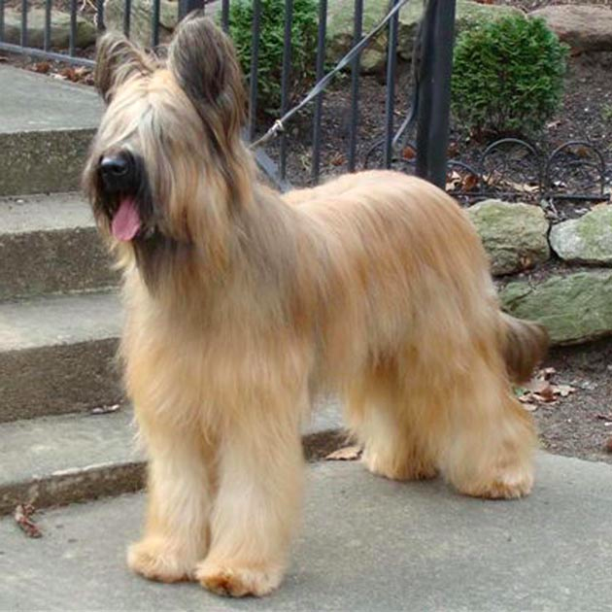
Challenge

Slide 38
Briard Challenge
Type the following in your browser:
http://www.htmlandcssbook.com/code-samples/chapter-12/example.html
Open the Developer Tools, click on the tab that says “Console”
Type each line of code, then press enter:
intro = document.getElementsByClassName(“intro”);
intro[0].innerHTML(“I love briards, they are so funny”);
What happens? (Try pressing refresh.)
Notes:
This is meant to show you just how easy it is to change the appearance of a real website.
At end, reveal that we haven’t actually changed anything.

Slide 39
Udacity Challenge
Type the following in your browser:
http://udacity.github.io/js-basics/static-home/index.html
Open the Developer Tools, click on the tab that says “Console”
Type the following code exactly the way it is here, then press enter: $(".super-header-wrapper").html("<img style='width:100%' src='http://goo.gl/WCrBmS'>");
What happens?
Notes:
The format is complicated, but we’ll start to learn more as time goes on.

Slide 40
finally{
talkAboutWhatWe’veLearned();
}
Notes:
Get answers from around the classroom:
1. Something that you learned today.
2. After today, how are you feeling?

Slide 41
Today’s Goals
Meet the Teachers & Procedures
Meet the Team
Discuss our goals
Discuss our workflow
Craft our team agreement
DEV TIME!
And now we’re done!
At least… by our definition of done.

